Slide 1
Dual Link Manipulator
Dynamical Model

Slide 2
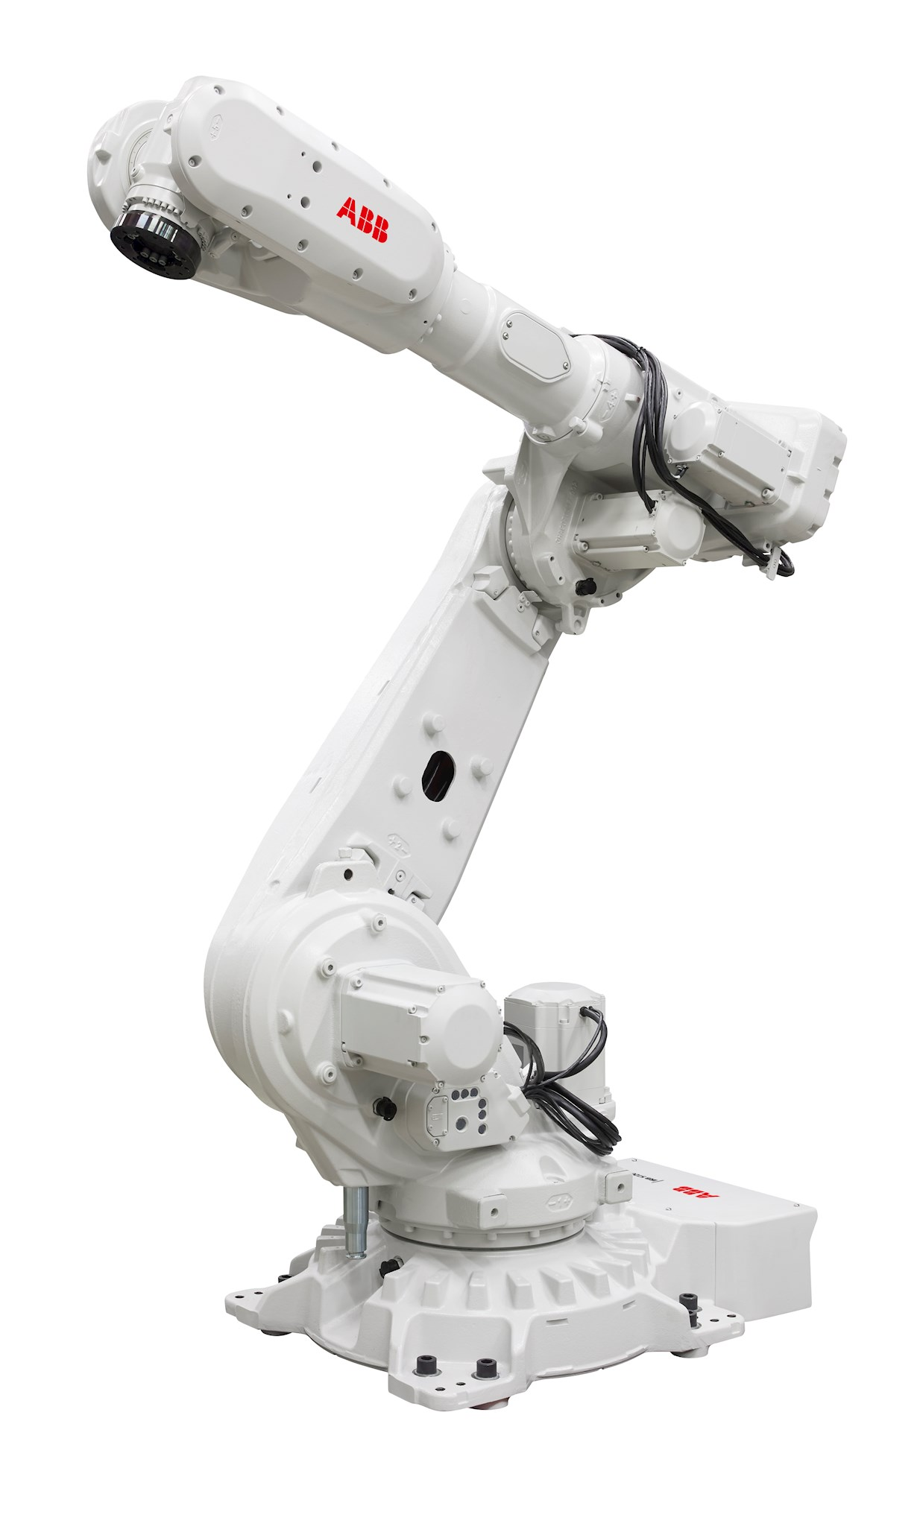

Dual Link Manipulator
Introduction
For this section, we’ll concentrate on a simple 2-link manipulator.
Some of the equations & analyses are surprisingly complex.
Is one of the most used configurations in the industry.
Can also be used to model legged robots.
Exhibits many of the basic locomotion problems associated with more complex skeleton models
IRB_5720
(ABB)
ASIMO
(Honda, Japan)

Slide 3
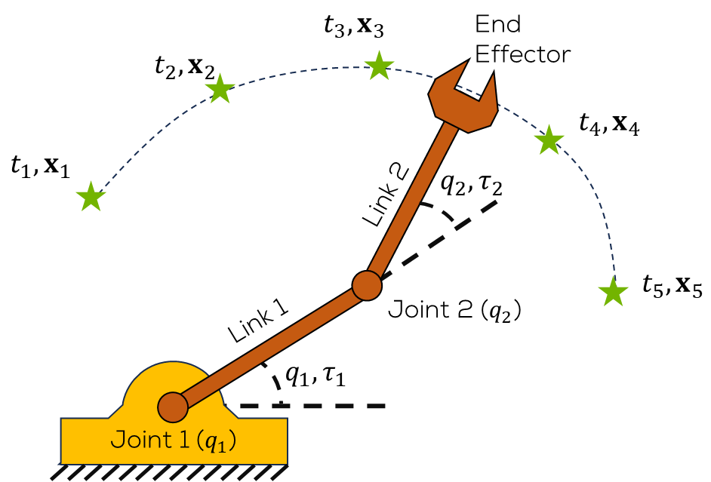
Dual Link Manipulator
Dual Link Manipulator (DLM)
Composed of 2 links and 2 joints
Joints are referenced to the horizontal.
We want to follow a trajectory with the end effector.
As with the SLM, a motor in each joint is usually used to move the links to a desired position.

Slide 4
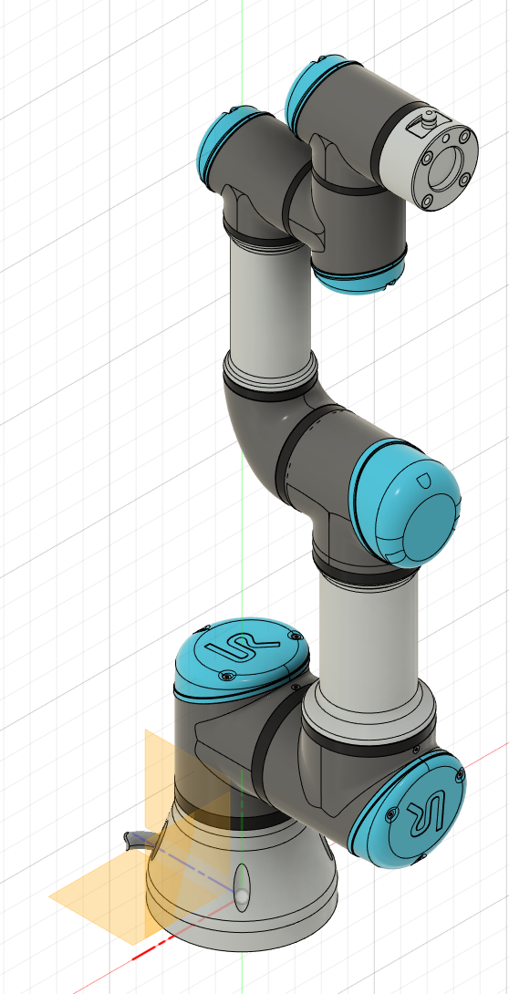
Dual Link Manipulator
Dual Link Manipulator
As for the previous SLM, the dynamics will be obtained using the Euler-Lagrange approach.
This analysis aims to enhance the comprehension of the intricate behaviour of the system and may be of interest to professionals working in this field.
Several levels of abstraction will be performed.

Slide 5

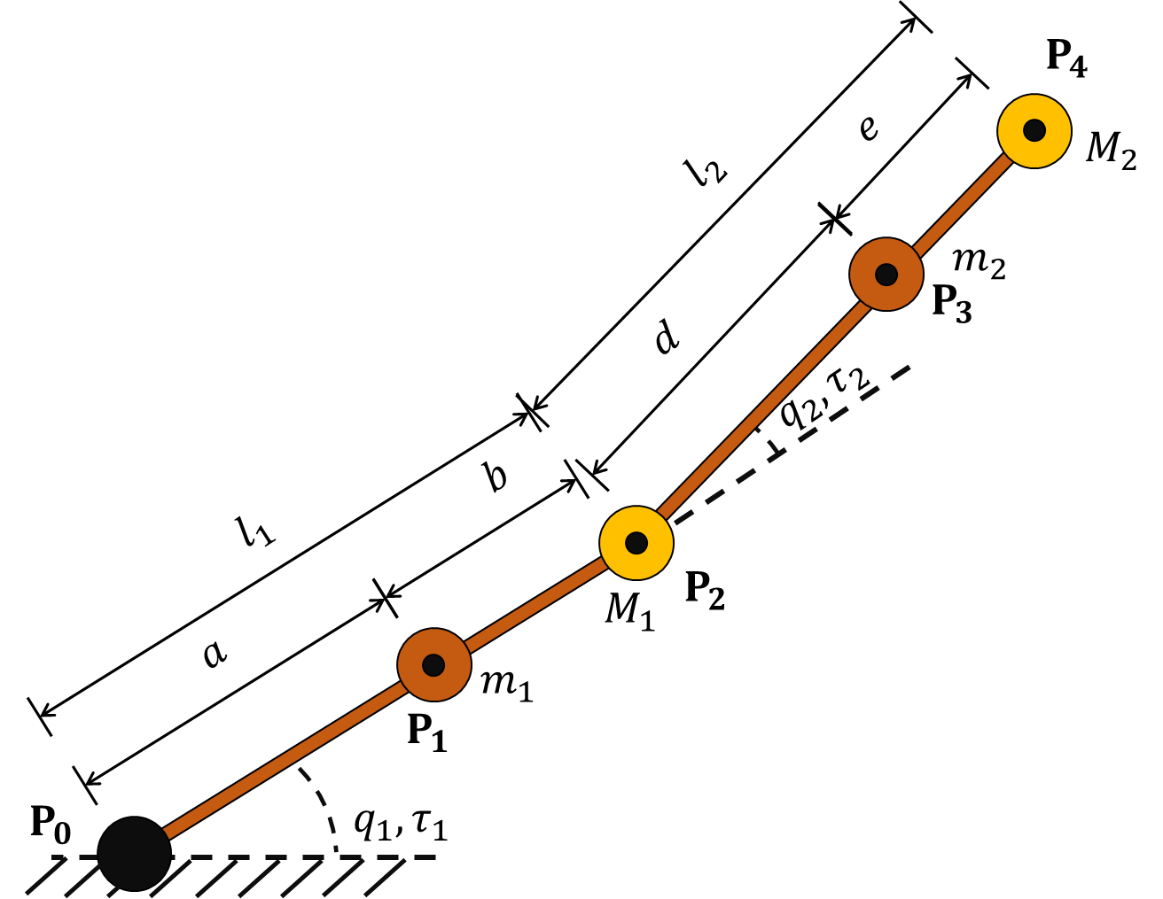

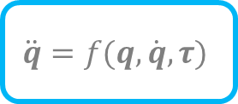

DLM Modelling
$$τ$$
$$\ddot{q}=f(q,\dot{q},τ)$$
$$q$$

Slide 6
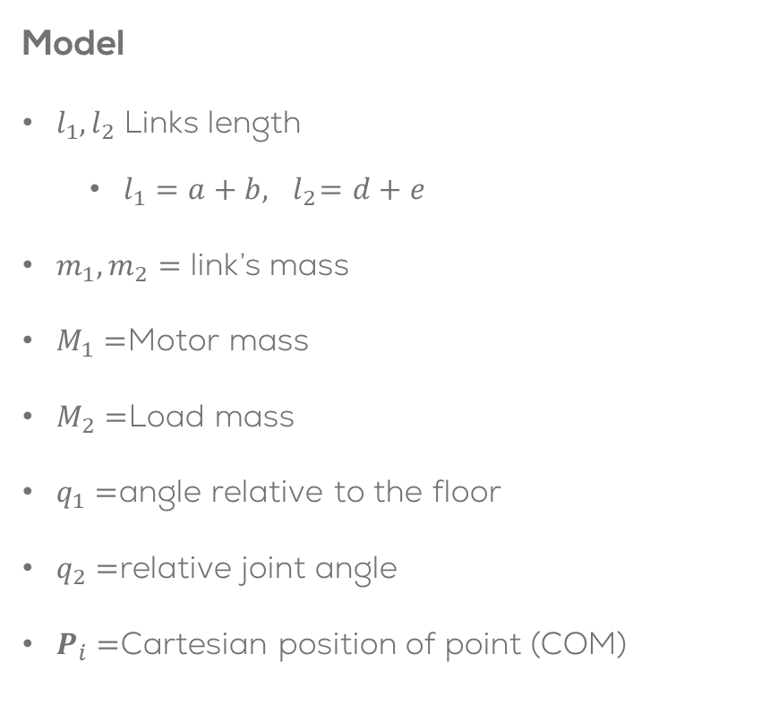
Dual Link Manipulator
Model
$l_{1}, l_{2}$ Links length
$l_{1}=a+b, { l}_{2}=d+e$
$m_{1}, m_{2}=$ link’s mass
$M_{1}=$Motor mass
$M_{2}=$Load mass
$q_{1}=$angle relative to the floor
$q_{2}=$relative joint angle
$P_{i}=$Cartesian position of point (COM)

Slide 7

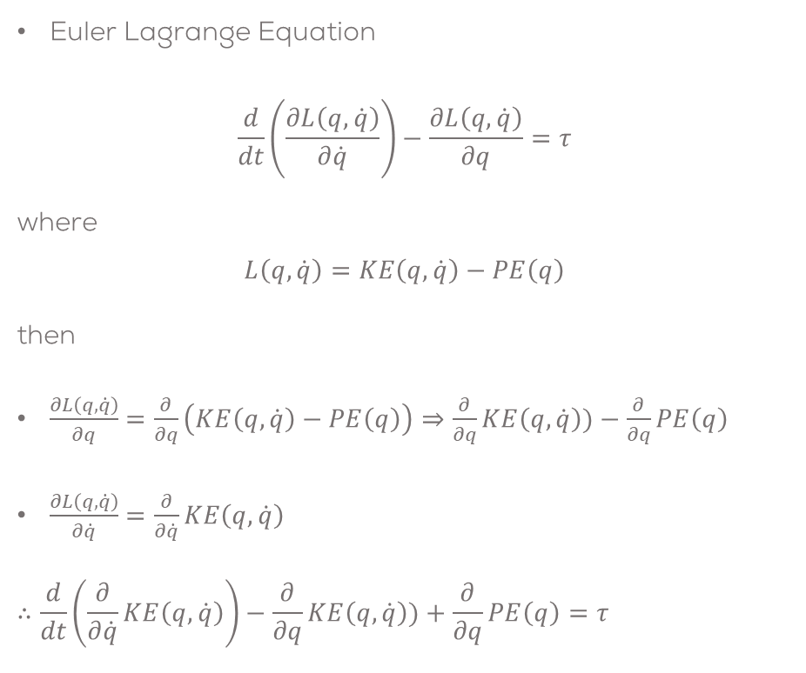
DLM Modelling
Euler Lagrange Equation
$$\frac{d}{dt}\left.\left(\frac{∂L\left(q,\dot{q}\right)}{∂\dot{q}}\right.\right)−\frac{∂L\left(q,\dot{q}\right)}{∂q}=τ$$
where
$$L\left(q,\dot{q}\right)=KE\left(q,\dot{q}\right)−PE\left(q\right)$$
then
$\frac{∂L\left(q,\dot{q}\right)}{∂q}=\frac{∂}{∂q}\left(KE\left(q,\dot{q}\right)−PE\left(q\right)\right)⇒\frac{∂}{∂q}KE\left(q,\dot{q}\right))−\frac{∂}{∂q}PE\left(q\right)$
$\frac{∂L\left(q,\dot{q}\right)}{∂\dot{q}}=\frac{∂}{∂\dot{q}}KE\left(q,\dot{q}\right)$
$$∴\frac{d}{dt}\left.\left(\frac{∂}{∂\dot{q}}KE\left(q,\dot{q}\right)\right.\right)−\frac{∂}{∂q}KE\left(q,\dot{q}\right))+\frac{∂}{∂q}PE\left(q\right)=τ$$

Slide 8
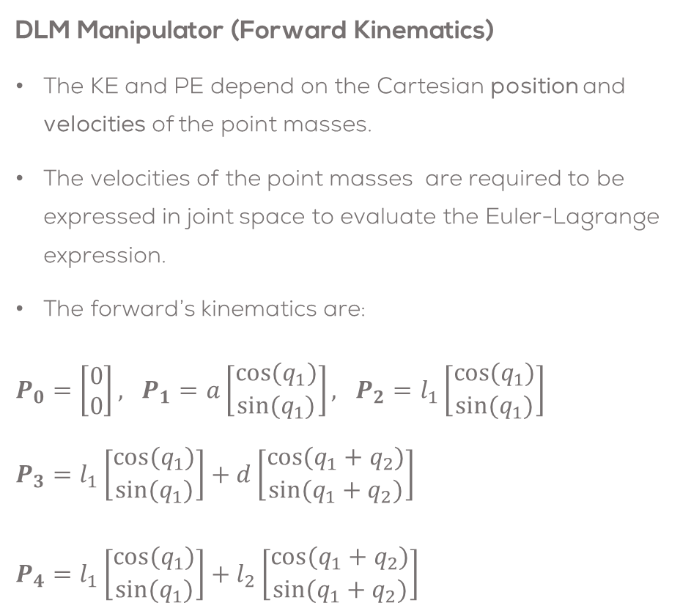
DLM Modelling
DLM Manipulator (Forward Kinematics)
The KE and PE depend on the Cartesian position and velocities of the point masses.
The velocities of the point masses are required to be expressed in joint space to evaluate the Euler-Lagrange expression.
The forward’s kinematics are:
$P_{0}=\left[\begin{matrix}0 \\ 0\end{matrix}\right], P_{1}=a\left[\begin{matrix}cos(q_{1}) \\ sin(q_{1})\end{matrix}\right], P_{2}=l_{1}\left[\begin{matrix}cos(q_{1}) \\ sin(q_{1})\end{matrix}\right]$ $P_{3}=l_{1}\left[\begin{matrix}cos(q_{1}) \\ sin(q_{1})\end{matrix}\right]+d\left[\begin{matrix}cos(q_{1}+q_{2}) \\ sin(q_{1}+q_{2})\end{matrix}\right]$
$P_{4}=l_{1}\left[\begin{matrix}cos(q_{1}) \\ sin(q_{1})\end{matrix}\right]+l_{2}\left[\begin{matrix}cos(q_{1}+q_{2}) \\ sin(q_{1}+q_{2})\end{matrix}\right]$

Slide 9
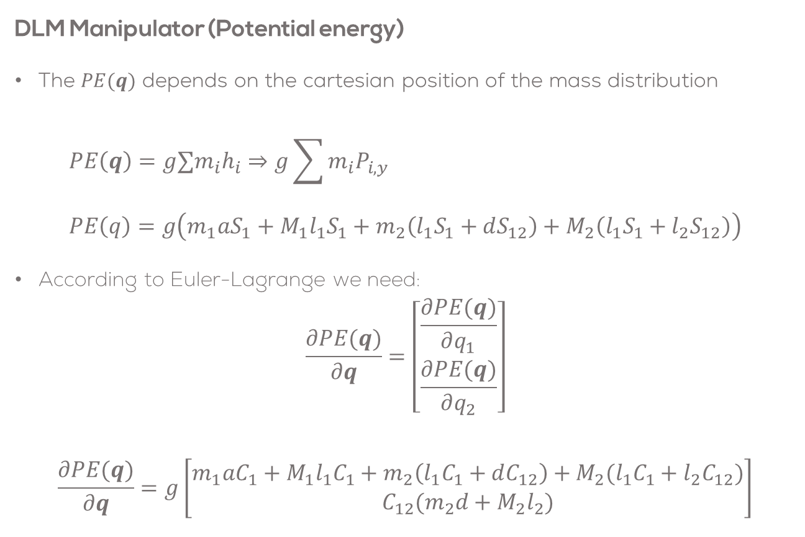
DLM Modelling
DLM Manipulator (Potential energy)
The $PE(q)$ depends on the cartesian position of the mass distribution
$$PE\left(q\right)=g∑m_{i}h_{i}⇒g\sum{m_{i}P_{i,y} } \\ PE\left(q\right)=g\left(m_{1}aS_{1}+M_{1}l_{1}S_{1}+m_{2}\left(l_{1}S_{1}+dS_{12}\right)+M_{2}\left(l_{1}S_{1}+l_{2}S_{12}\right)\right)$$
According to Euler-Lagrange we need:
$$\frac{∂PE(q)}{∂q}=\left[\begin{matrix}\frac{∂PE(q)}{∂q_{1}} \\ \frac{∂PE(q)}{∂q_{2}}\end{matrix}\right]$$
$$\frac{∂PE(q)}{∂q}=g\left[\begin{matrix}m_{1}aC_{1}+M_{1}l_{1}C_{1}+m_{2}\left(l_{1}C_{1}+dC_{12}\right)+M_{2}(l_{1}C_{1}+l_{2}C_{12}) \\ C_{12}(m_{2}d+M_{2}l_{2})\end{matrix}\right]$$

Slide 10
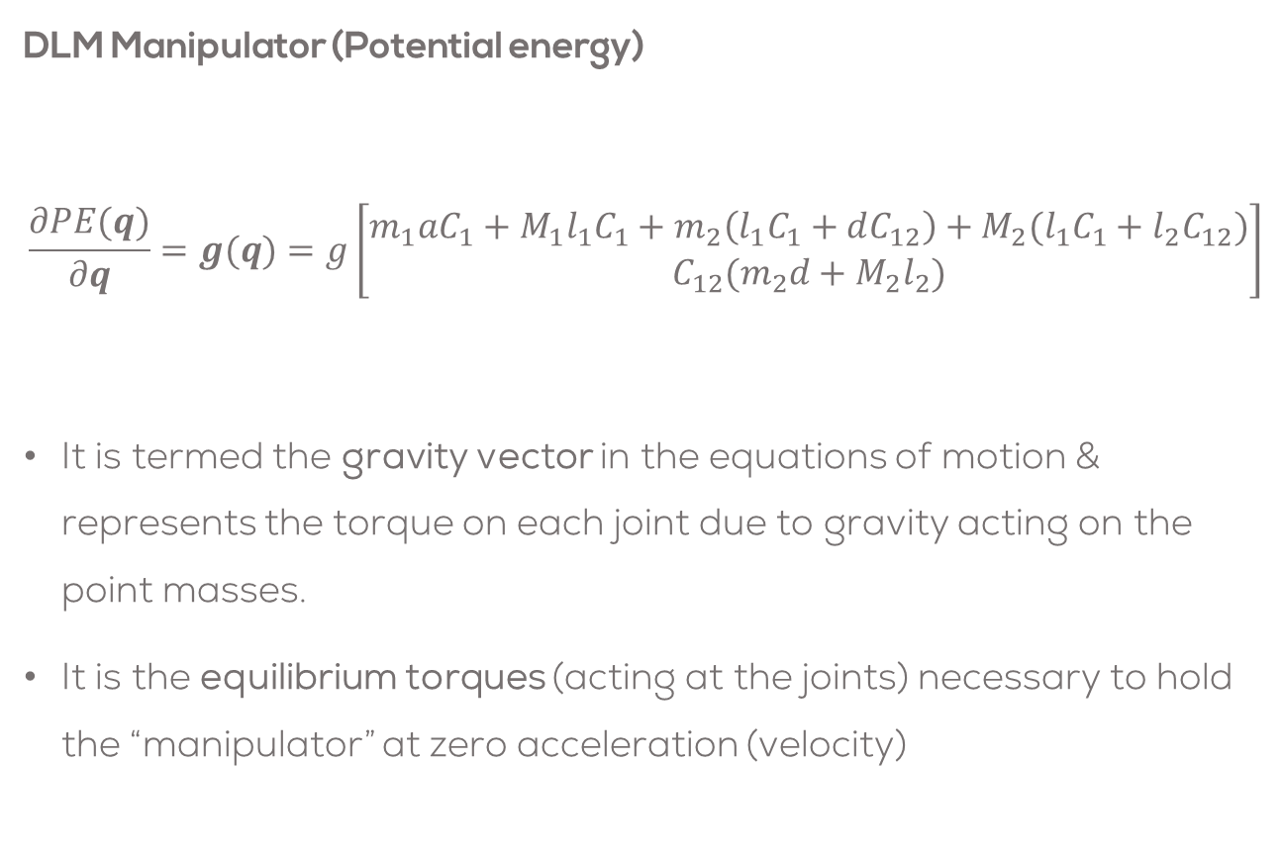
DLM Modelling
DLM Manipulator (Potential energy)
$$\frac{∂PE(q)}{∂q}=g(q)=g\left[\begin{matrix}m_{1}aC_{1}+M_{1}l_{1}C_{1}+m_{2}\left(l_{1}C_{1}+dC_{12}\right)+M_{2}(l_{1}C_{1}+l_{2}C_{12}) \\ C_{12}(m_{2}d+M_{2}l_{2})\end{matrix}\right]$$
It is termed the gravity vector in the equations of motion & represents the torque on each joint due to gravity acting on the point masses.
It is the equilibrium torques (acting at the joints) necessary to hold the “manipulator” at zero acceleration (velocity)

Slide 11
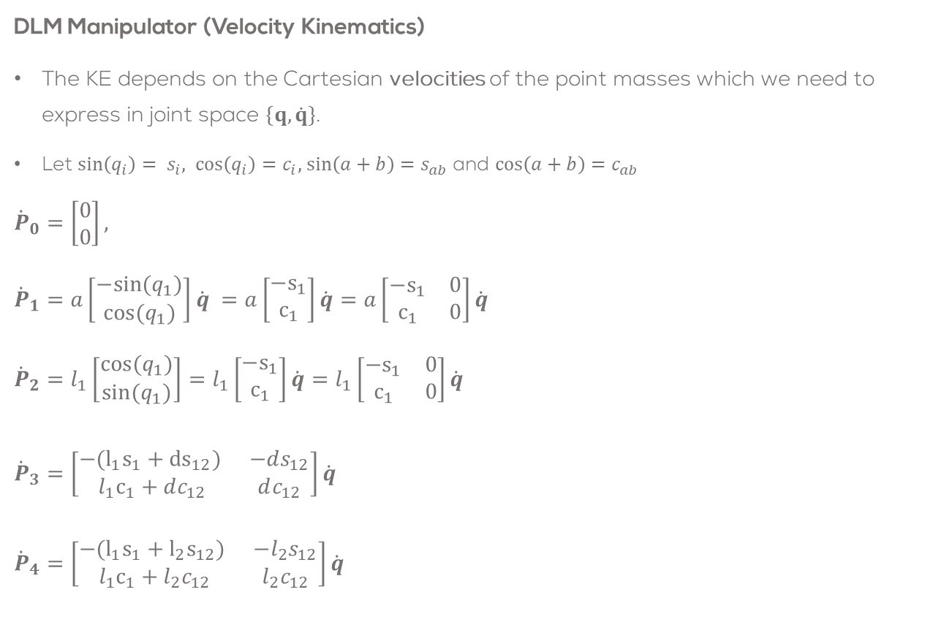
DLM Modelling
DLM Manipulator (Velocity Kinematics)
The KE depends on the Cartesian velocities of the point masses which we need to express in joint space $\{q,\dot{q}\}$.
Let $\sin\left(q_{i}\right)= s_{i}, \cos\left(q_{i}\right)=c_{i},$ $\sin\left(a+b\right)=s_{ab}$ and $\cos\left(a+b\right)=c_{ab}$
$${\dot{P}}_{0}=\left[\begin{matrix}0 \\ 0\end{matrix}\right],$$
$${\dot{P}}_{1}=a\left[\begin{matrix}−sin(q_{1}) \\ cos(q_{1})\end{matrix}\right]\dot{q} =a\left[\begin{matrix}−s_{1} \\ c_{1}\end{matrix}\right]\dot{q}=a\left[\begin{matrix}−s_{1} & 0 \\ c_{1} & 0\end{matrix}\right]\dot{q}$$
$${\dot{P}}_{2}=l_{1}\left[\begin{matrix}cos(q_{1}) \\ sin(q_{1})\end{matrix}\right]=l_{1}\left[\begin{matrix}−s_{1} \\ c_{1}\end{matrix}\right]\dot{q}=l_{1}\left[\begin{matrix}−s_{1} & 0 \\ c_{1} & 0\end{matrix}\right]\dot{q}$$ ${\dot{P}}_{3}=\left[\begin{matrix}−(l_{1}s_{1}+{ds}_{12}) & −ds_{12} \\ l_{1}c_{1}+dc_{12} & dc_{12}\end{matrix}\right]\dot{q}$
${\dot{P}}_{4}=\left[\begin{matrix}−(l_{1}s_{1}+{l_{2}s}_{12}) & −l_{2}s_{12} \\ l_{1}c_{1}+l_{2}c_{12} & l_{2}c_{12}\end{matrix}\right]\dot{q}$

Slide 12
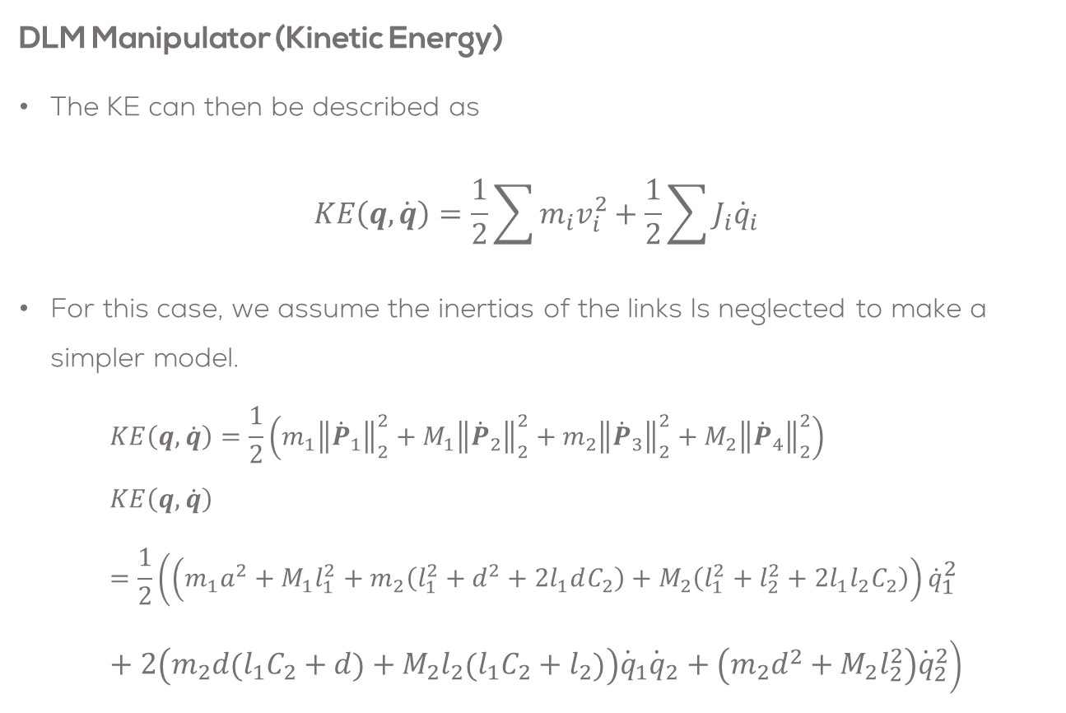
DLM Modelling
DLM Manipulator (Kinetic Energy)
The KE can then be described as
$$KE\left(q,\dot{q}\right)=\frac{1}{2}\sum{m_{i}v_{i}^{2}}+\frac{1}{2}\sum{J_{i}{\dot{q}}_{i}}$$
For this case, we assume the inertias of the links Is neglected to make a simpler model.
$$KE\left(q,\dot{q}\right)=\frac{1}{2}\left(m_{1}{\left\|{\dot{P}}_{1}\right\|}_{2}^{2}+M_{1}{\left\|{\dot{P}}_{2}\right\|}_{2}^{2}+m_{2}{\left\|{\dot{P}}_{3}\right\|}_{2}^{2}+M_{2}{\left\|{\dot{P}}_{4}\right\|}_{2}^{2}\right) \\ KE\left(q,\dot{q}\right)=\frac{1}{2}\left(\left(m_{1}a^{2}+M_{1}l_{1}^{2}+m_{2}\left(l_{1}^{2}+d^{2}+2l_{1}dC_{2}\right)+M_{2}\left(l_{1}^{2}+l_{2}^{2}+2l_{1}l_{2}C_{2}\right)\right){\dot{q}}_{1}^{2}+2\left(m_{2}d\left(l_{1}C_{2}+d\right)+M_{2}l_{2}\left(l_{1}C_{2}+l_{2}\right)\right){\dot{q}}_{1}{\dot{q}}_{2}+\left(m_{2}d^{2}+M_{2}l_{2}^{2}\right){\dot{q}}_{2}^{2}\right)$$

Slide 13
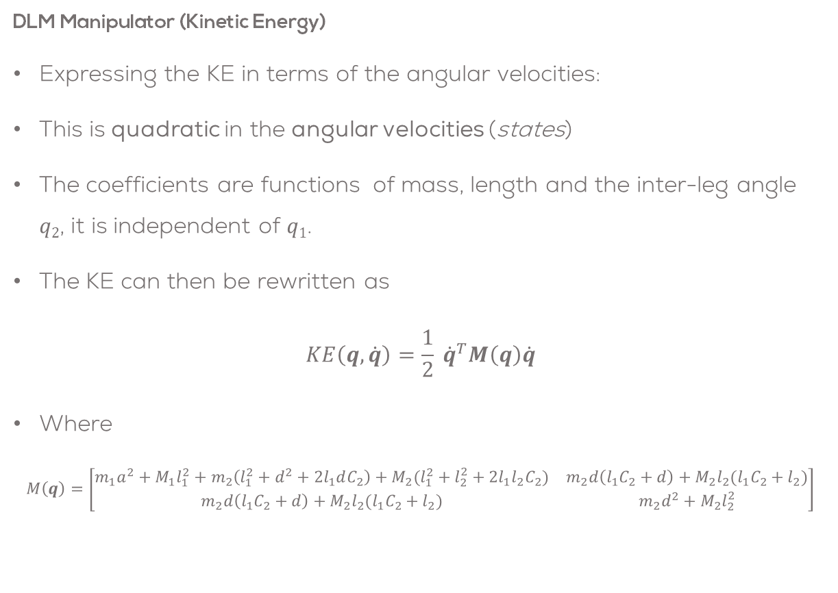
DLM Modelling
DLM Manipulator (Kinetic Energy)
Expressing the KE in terms of the angular velocities:
This is quadratic in the angular velocities (states)
The coefficients are functions of mass, length and the inter-leg angle $q2$, it is independent of $q1$.
The KE can then be rewritten as
$$KE\left(q,\dot{q}\right)=\frac{1}{2} {\dot{q}}^{T}M\left(q\right)\dot{q}$$
Where
$$M\left(q\right)=\left[\begin{matrix}m_{1}a^{2}+M_{1}l_{1}^{2}+m_{2}\left(l_{1}^{2}+d^{2}+2l_{1}dC_{2}\right)+M_{2}(l_{1}^{2}+l_{2}^{2}+2l_{1}l_{2}C_{2}) & m_{2}d\left(l_{1}C_{2}+d\right)+M_{2}l_{2}(l_{1}C_{2}+l_{2}) \\ m_{2}d\left(l_{1}C_{2}+d\right)+M_{2}l_{2}(l_{1}C_{2}+l_{2}) & m_{2}d^{2}+M_{2}l_{2}^{2}\end{matrix}\right]$$

Slide 14
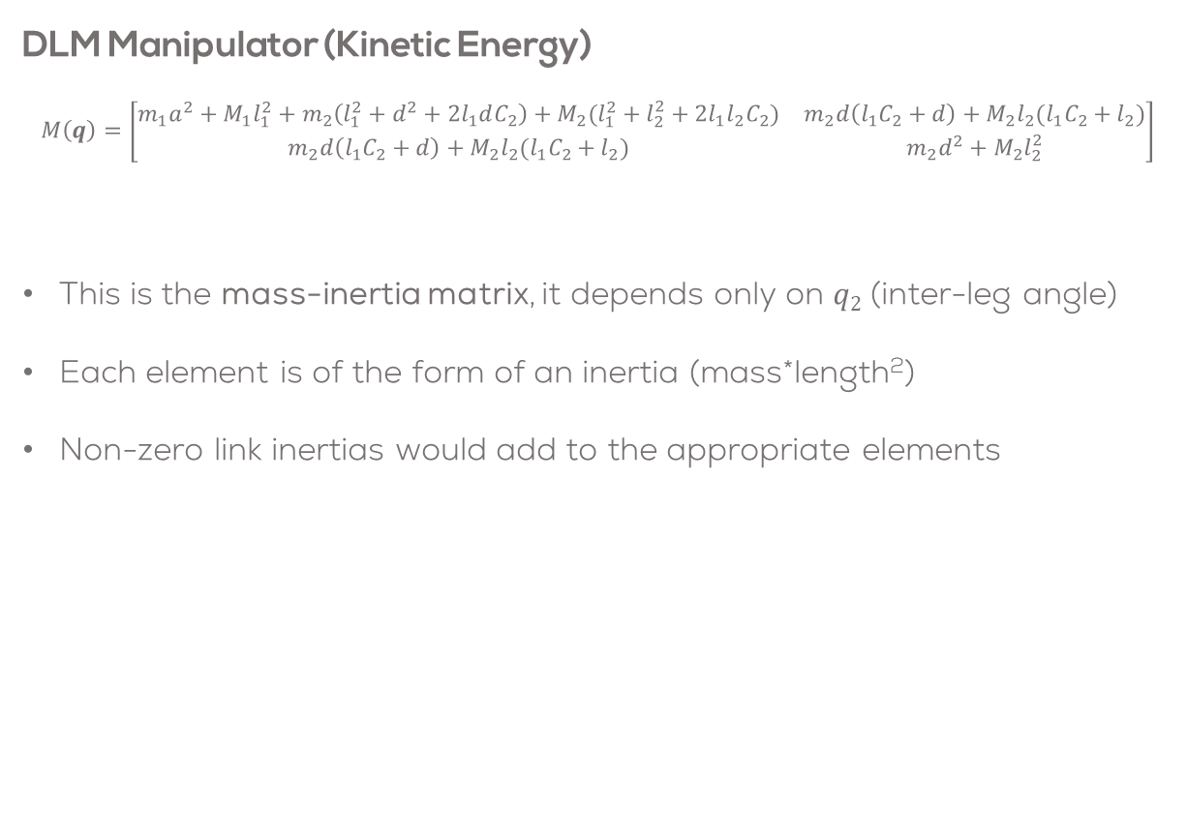
DLM Modelling
DLM Manipulator (Kinetic Energy)
$$M\left(q\right)=\left[\begin{matrix}m_{1}a^{2}+M_{1}l_{1}^{2}+m_{2}\left(l_{1}^{2}+d^{2}+2l_{1}dC_{2}\right)+M_{2}(l_{1}^{2}+l_{2}^{2}+2l_{1}l_{2}C_{2}) & m_{2}d\left(l_{1}C_{2}+d\right)+M_{2}l_{2}(l_{1}C_{2}+l_{2}) \\ m_{2}d\left(l_{1}C_{2}+d\right)+M_{2}l_{2}(l_{1}C_{2}+l_{2}) & m_{2}d^{2}+M_{2}l_{2}^{2}\end{matrix}\right]$$
This is the mass-inertia matrix, it depends only on $q2$ (inter-leg angle)
Each element is of the form of an inertia (mass*length²)
Non-zero link inertias would add to the appropriate elements

Slide 15
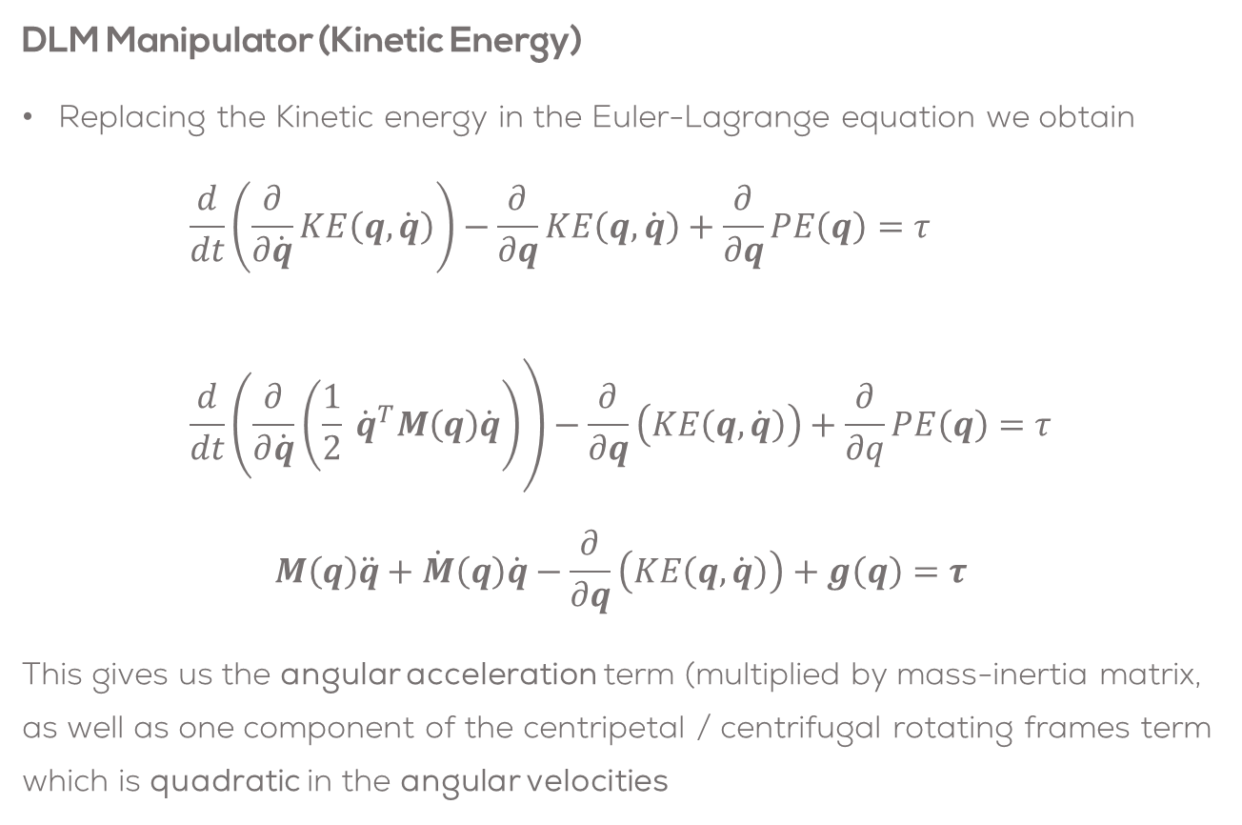
DLM Modelling
DLM Manipulator (Kinetic Energy)
Replacing the Kinetic energy in the Euler-Lagrange equation we obtain
$$\frac{d}{dt}\left.\left(\frac{∂}{∂\dot{q}}KE\left(q,\dot{q}\right)\right.\right)−\frac{∂}{∂q}KE\left(q,\dot{q}\right)+\frac{∂}{∂q}PE\left(q\right)=τ \\ \frac{d}{dt}\left.\left(\frac{∂}{∂\dot{q}}\right.\left(\frac{1}{2} {\dot{q}}^{T}M\left(q\right)\dot{q}\right)\right)−\frac{∂}{∂q}\left(KE\left(q,\dot{q}\right)\right)+\frac{∂}{∂q}PE\left(q\right)=τ$$
$$M\left(q\right)\ddot{q}+\dot{M}\left(q\right)\dot{q}−\frac{∂}{∂q}\left(KE\left(q,\dot{q}\right)\right)+g\left(q\right)=τ$$
This gives us the angular acceleration term (multiplied by mass-inertia matrix, as well as one component of the centripetal / centrifugal rotating frames term which is quadratic in the angular velocities

Slide 16

DLM Modelling
DLM Manipulator (Kinetic Energy)
Let
$$C\left(q,\dot{q}\right)\dot{q}=\dot{M}\left(q\right)\dot{q}−\frac{∂}{∂q}\left(KE\left(q,\dot{q}\right)\right)$$
Then
$$M\left(q\right)\ddot{q}+C\left(q,\dot{q}\right)\dot{q}+g\left(q\right)=τ$$
Where
$$\dot{M}\left(q\right)=\left[\begin{matrix}−2l_{1}S_{2}\left(m_{2}d+M_{2}l_{2}\right){\dot{q}}_{2} & −l_{1}S_{2}\left(m_{2}d+M_{2}l_{2}\right){\dot{q}}_{2} \\ −l_{1}S_{2}\left(m_{2}d+M_{2}l_{2}\right){\dot{q}}_{2} & 0\end{matrix}\right]$$

Slide 17
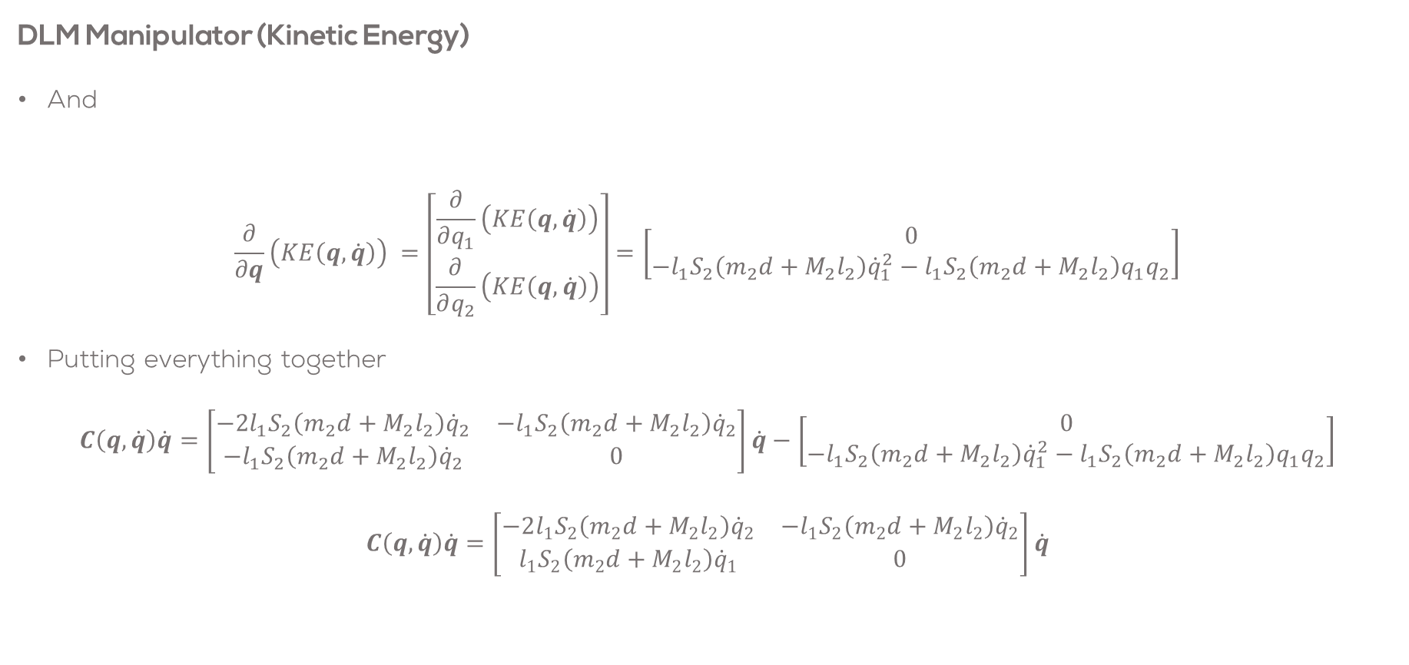
DLM Modelling
DLM Manipulator (Kinetic Energy)
And
$$\frac{∂}{∂q}\left(KE\left(q,\dot{q}\right)\right) =\left[\begin{matrix}\frac{∂}{∂q_{1}}\left(KE\left(q,\dot{q}\right)\right) \\ \frac{∂}{∂q_{2}}\left(KE\left(q,\dot{q}\right)\right)\end{matrix}\right]=\left[\begin{matrix}0 \\ −l_{1}S_{2}\left(m_{2}d+M_{2}l_{2}\right){\dot{q}}_{1}^{2}−l_{1}S_{2}\left(m_{2}d+M_{2}l_{2}\right)q_{1}q_{2}\end{matrix}\right]$$
Putting everything together
$$C\left(q,\dot{q}\right)\dot{q}=\left[\begin{matrix}−2l_{1}S_{2}\left(m_{2}d+M_{2}l_{2}\right){\dot{q}}_{2} & −l_{1}S_{2}\left(m_{2}d+M_{2}l_{2}\right){\dot{q}}_{2} \\ −l_{1}S_{2}\left(m_{2}d+M_{2}l_{2}\right){\dot{q}}_{2} & 0\end{matrix}\right]\dot{q}−\left[\begin{matrix}0 \\ −l_{1}S_{2}\left(m_{2}d+M_{2}l_{2}\right){\dot{q}}_{1}^{2}−l_{1}S_{2}\left(m_{2}d+M_{2}l_{2}\right)q_{1}q_{2}\end{matrix}\right]$$
$$C\left(q,\dot{q}\right)\dot{q}=\left[\begin{matrix}−2l_{1}S_{2}\left(m_{2}d+M_{2}l_{2}\right){\dot{q}}_{2} & −l_{1}S_{2}\left(m_{2}d+M_{2}l_{2}\right){\dot{q}}_{2} \\ l_{1}S_{2}\left(m_{2}d+M_{2}l_{2}\right){\dot{q}}_{1} & 0\end{matrix}\right]\dot{q}$$

Slide 18
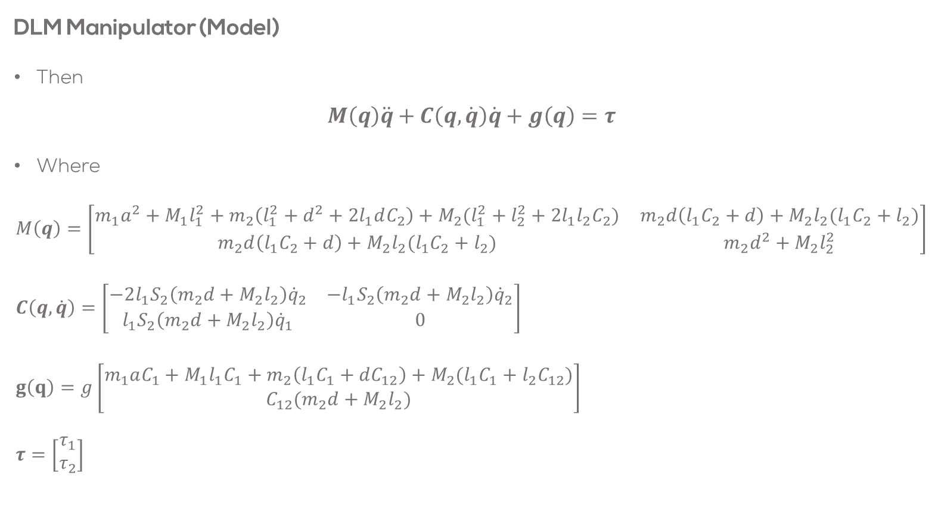
DLM Modelling
DLM Manipulator (Model)
Then
$$M\left(q\right)\ddot{q}+C\left(q,\dot{q}\right)\dot{q}+g\left(q\right)=τ$$
Where
$$M\left(q\right)=\left[\begin{matrix}m_{1}a^{2}+M_{1}l_{1}^{2}+m_{2}\left(l_{1}^{2}+d^{2}+2l_{1}dC_{2}\right)+M_{2}(l_{1}^{2}+l_{2}^{2}+2l_{1}l_{2}C_{2}) & m_{2}d\left(l_{1}C_{2}+d\right)+M_{2}l_{2}(l_{1}C_{2}+l_{2}) \\ m_{2}d\left(l_{1}C_{2}+d\right)+M_{2}l_{2}(l_{1}C_{2}+l_{2}) & m_{2}d^{2}+M_{2}l_{2}^{2}\end{matrix}\right] \\ C\left(q,\dot{q}\right)=\left[\begin{matrix}−2l_{1}S_{2}\left(m_{2}d+M_{2}l_{2}\right){\dot{q}}_{2} & −l_{1}S_{2}\left(m_{2}d+M_{2}l_{2}\right){\dot{q}}_{2} \\ l_{1}S_{2}\left(m_{2}d+M_{2}l_{2}\right){\dot{q}}_{1} & 0\end{matrix}\right] \\ g\left(q\right)=g\left[\begin{matrix}m_{1}aC_{1}+M_{1}l_{1}C_{1}+m_{2}\left(l_{1}C_{1}+dC_{12}\right)+M_{2}(l_{1}C_{1}+l_{2}C_{12}) \\ C_{12}(m_{2}d+M_{2}l_{2})\end{matrix}\right] \\ τ=\left[\begin{matrix}τ_{1} \\ τ_{2}\end{matrix}\right]$$
Mass (inertia) matrix (mass*length²)
Centrifugal / centripetal vector of rotational forces
(mass*length²*velocity²)
Gravity vector. Torques required to counteract gravity (force*length)
Vector of applied (joint) torques. For the passive compass gait, this is zero

Slide 19
Conclusions
While a little complex, the equations of motion of the compass gait (double link, planar) robot can be derived using Euler-Lagrange. It is difficult to do this using a simple balance approach.
The equations of motion contain the non-linear, 2nd order relationships between the applied joint torques (inputs) and the joint angles (accelerations) (outputs)

Slide 20
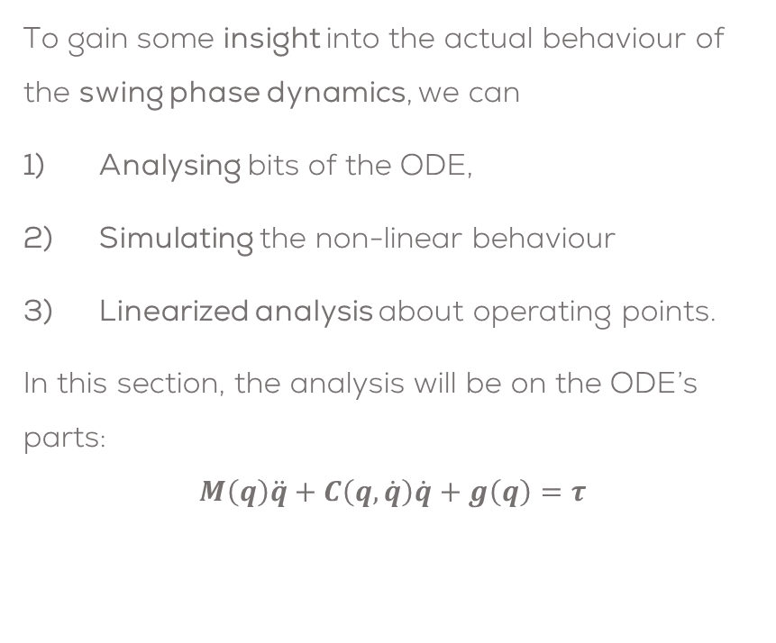
Interpreting & Simulating the Model
To gain some insight into the actual behaviour of the swing phase dynamics, we can
Analysing bits of the ODE,
Simulating the non-linear behaviour
Linearized analysis about operating points.
In this section, the analysis will be on the ODE’s parts:
$$M\left(q\right)\ddot{q}+C\left(q,\dot{q}\right)\dot{q}+g\left(q\right)=τ$$
We typically assume the other terms on the left hand size are zero and analyse each term independently
Simulate the autonomous behaviour
Implement in ROS/Simulink/Matlab
Analyse autonomous response
Mass-Inertia
matrix
Rotational
effects
Gravity
vector

Slide 21
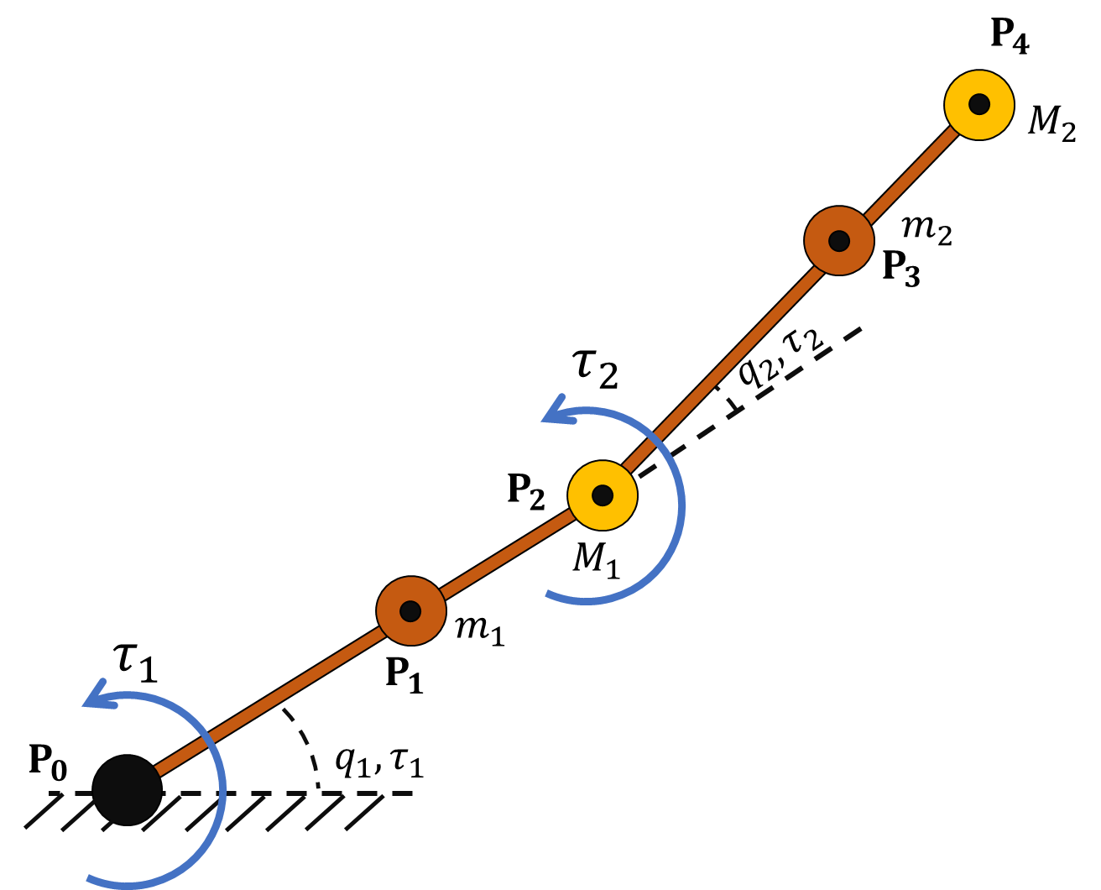
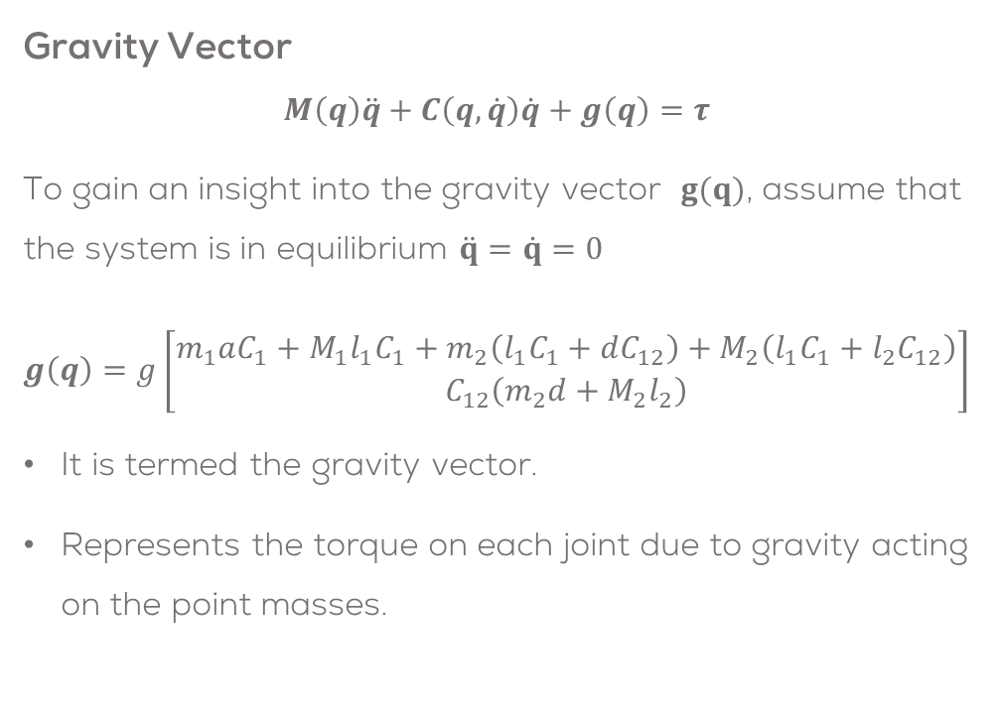
Gravity Vector & Equilibrium Torque
Gravity Vector
$$M\left(q\right)\ddot{q}+C\left(q,\dot{q}\right)\dot{q}+g\left(q\right)=τ$$
To gain an insight into the gravity vector $g(q)$, assume that the system is in equilibrium $\ddot{q}=\dot{q}=0$
$$g\left(q\right)=g\left[\begin{matrix}m_{1}aC_{1}+M_{1}l_{1}C_{1}+m_{2}\left(l_{1}C_{1}+dC_{12}\right)+M_{2}\left(l_{1}C_{1}+l_{2}C_{12}\right) \\ C_{12}\left(m_{2}d+M_{2}l_{2}\right)\end{matrix}\right]$$
It is termed the gravity vector.
Represents the torque on each joint due to gravity acting on the point masses.
It represents the equilibrium torques (acting at the joints) necessary to hold the “manipulator” at zero acceleration (velocity)
A direct generalization of the same concept for the single link manipulator

Slide 22
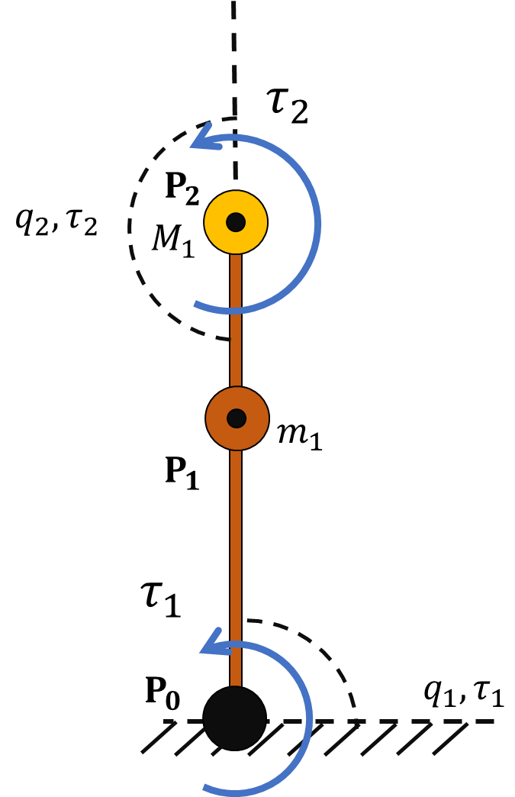
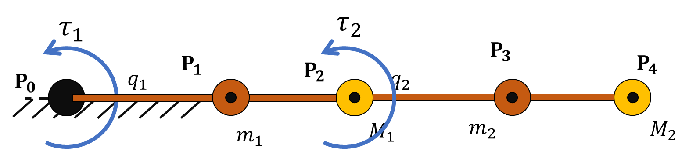


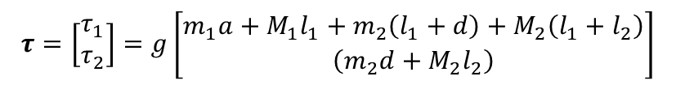
Examples Equilibrium Torque
Examples
Vertical Upright ($q_{1}=\frac{π}{2}, q_{2}=π$): The equilibrium joint torques are both zero as the legs are in an unstable equilibrium configuration.
Max Static Torque Position ($q_{1}=0, q_{2}=0$): This represents a (static) posture. The calculated torques assume zero velocity which isn’t a realistic part of the cycle, but the values for the exemplar manipulator are:
$$τ=\left[\begin{matrix}τ_{1} \\ τ_{2}\end{matrix}\right]=g\left[\begin{matrix}m_{1}a+M_{1}l_{1}+m_{2}\left(l_{1}+d\right)+M_{2}\left(l_{1}+l_{2}\right) \\ \left(m_{2}d+M_{2}l_{2}\right)\end{matrix}\right]$$

Slide 23
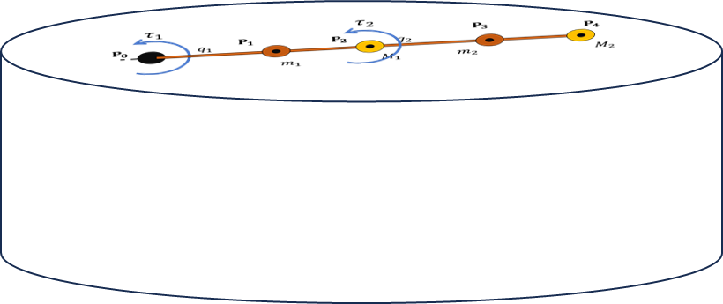
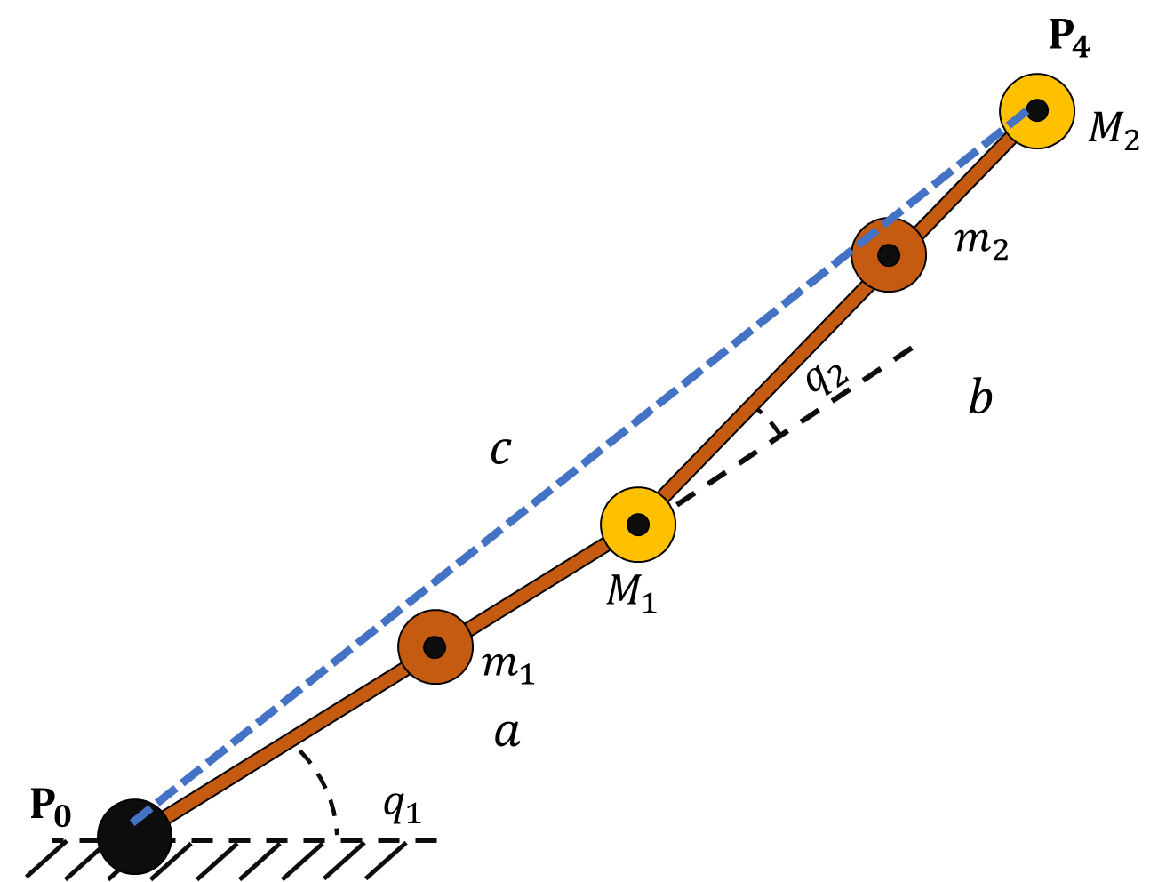
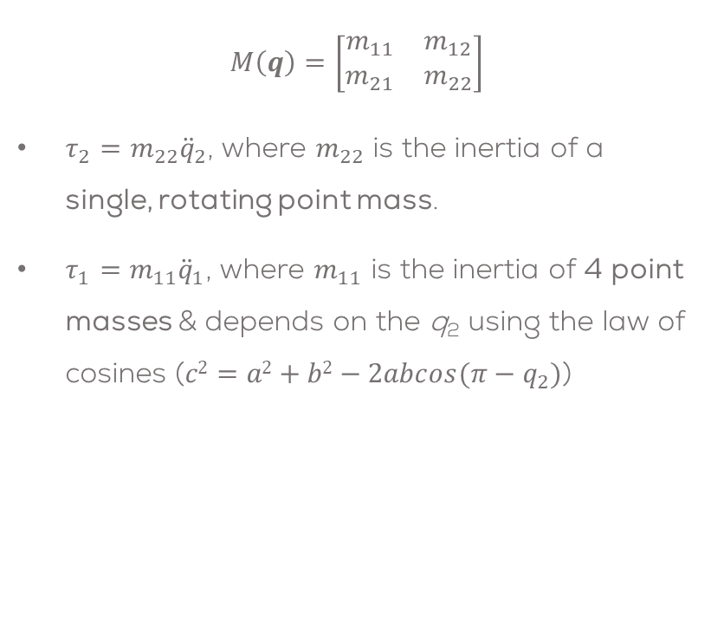
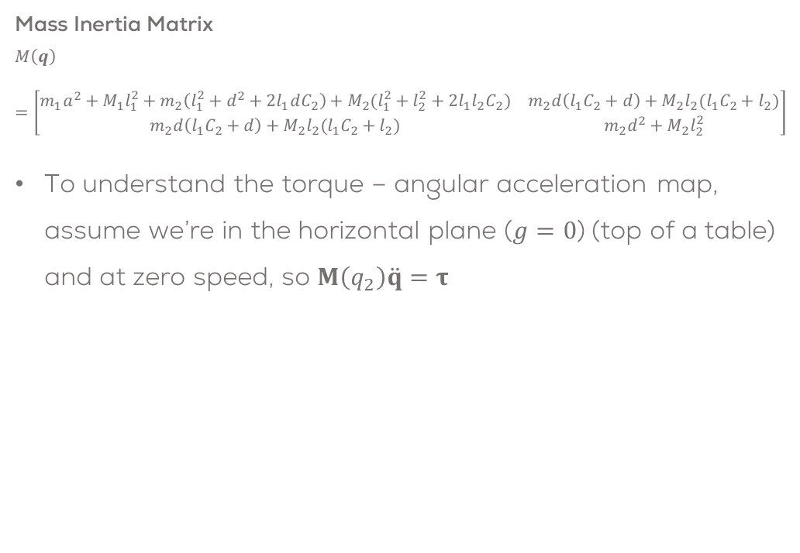
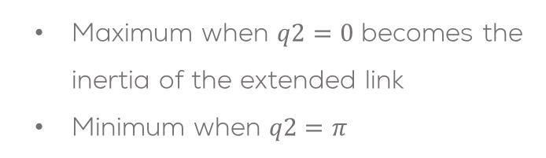
Interpreting the Mass Inertia Matrix
Mass Inertia Matrix
$$M\left(q\right)=\left[\begin{matrix}m_{1}a^{2}+M_{1}l_{1}^{2}+m_{2}\left(l_{1}^{2}+d^{2}+2l_{1}dC_{2}\right)+M_{2}(l_{1}^{2}+l_{2}^{2}+2l_{1}l_{2}C_{2}) & m_{2}d\left(l_{1}C_{2}+d\right)+M_{2}l_{2}(l_{1}C_{2}+l_{2}) \\ m_{2}d\left(l_{1}C_{2}+d\right)+M_{2}l_{2}(l_{1}C_{2}+l_{2}) & m_{2}d^{2}+M_{2}l_{2}^{2}\end{matrix}\right]$$
To understand the torque – angular acceleration map, assume we’re in the horizontal plane ($g=0$) (top of a table) and at zero speed, so $M\left(q_{2}\right)\ddot{q}=τ$
$$M\left(q\right)=\left[\begin{matrix}m_{11} & m_{12} \\ m_{21} & m_{22}\end{matrix}\right]$$
$τ_{2}=m_{22}{\ddot{q}}_{2}$, where $m_{22}$ is the inertia of a single, rotating point mass.
$τ_{1}=m_{11}{\ddot{q}}_{1}$, where $m_{11}$ is the inertia of 4 point masses & depends on the q₂ using the law of cosines ($c2=a2+b2−2abcos(π−q_{2})$)
Maximum when $q2=0$ becomes the inertia of the extended link
Minimum when $q2=π$

Slide 24
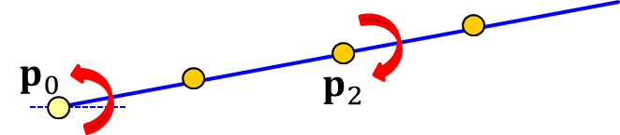
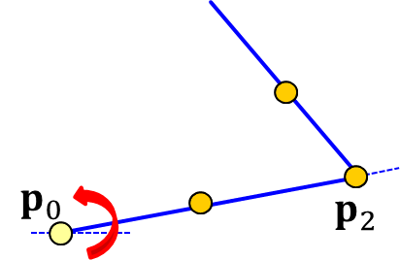
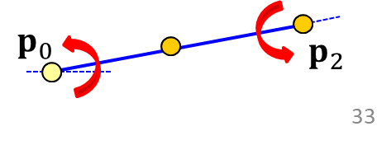

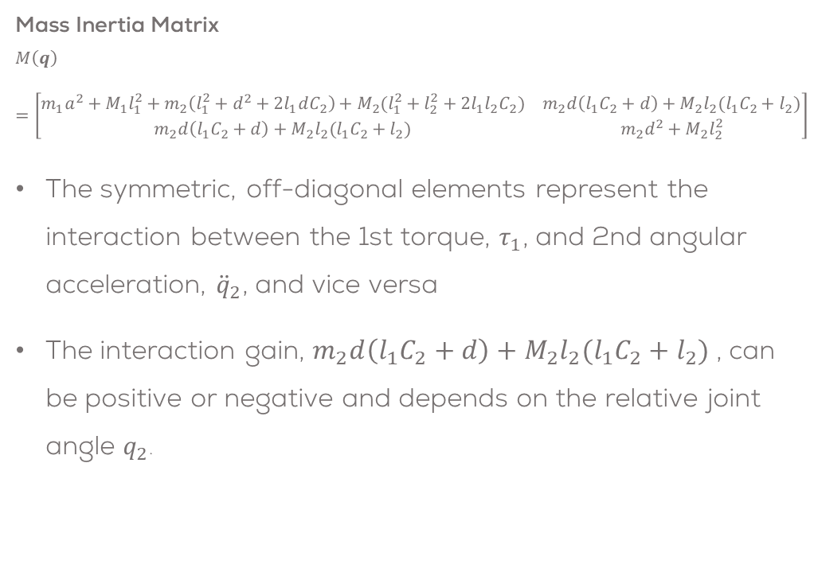
Interpreting the Mass Inertia Matrix 1
Mass Inertia Matrix
$$M\left(q\right)=\left[\begin{matrix}m_{1}a^{2}+M_{1}l_{1}^{2}+m_{2}\left(l_{1}^{2}+d^{2}+2l_{1}dC_{2}\right)+M_{2}(l_{1}^{2}+l_{2}^{2}+2l_{1}l_{2}C_{2}) & m_{2}d\left(l_{1}C_{2}+d\right)+M_{2}l_{2}(l_{1}C_{2}+l_{2}) \\ m_{2}d\left(l_{1}C_{2}+d\right)+M_{2}l_{2}(l_{1}C_{2}+l_{2}) & m_{2}d^{2}+M_{2}l_{2}^{2}\end{matrix}\right]$$
The symmetric, off-diagonal elements represent the interaction between the 1st torque, $τ_{1}$, and 2nd angular acceleration, ${\ddot{q}}_{2}$, and vice versa
The interaction gain, $m_{2}d\left(l_{1}C_{2}+d\right)+M_{2}l_{2}(l_{1}C_{2}+l_{2})$ , can be positive or negative and depends on the relative joint angle $q_{2}$.
positive gain when$m_{2}d\left(l_{1}C_{2}+d\right)+M_{2}l_{2}(l_{1}C_{2}+l_{2})>0$ & $τ_{1}>0$
$$τ_{2}=0→{\ddot{q}}_{1}>0→{\ddot{q}}_{2}<0$$
maximum when $q_{2}=0$
Zero gain (independent) when$m_{2}d\left(l_{1}C_{2}+d\right)+M_{2}l_{2}(l_{1}C_{2}+l_{2})=0$ & $τ_{1}>0$
$$τ_{2}=0→{\ddot{q}}_{1}>0→{\ddot{q}}_{2}=0$$
Negative gain when$m_{2}d\left(l_{1}C_{2}+d\right)+M_{2}l_{2}(l_{1}C_{2}+l_{2})<0$ & $τ_{1}>0$
$$τ_{2}=0→{\ddot{q}}_{1}>0→{\ddot{q}}_{2}>0$$
minimum when $q_{2}=π$

Slide 25
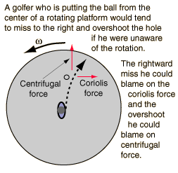

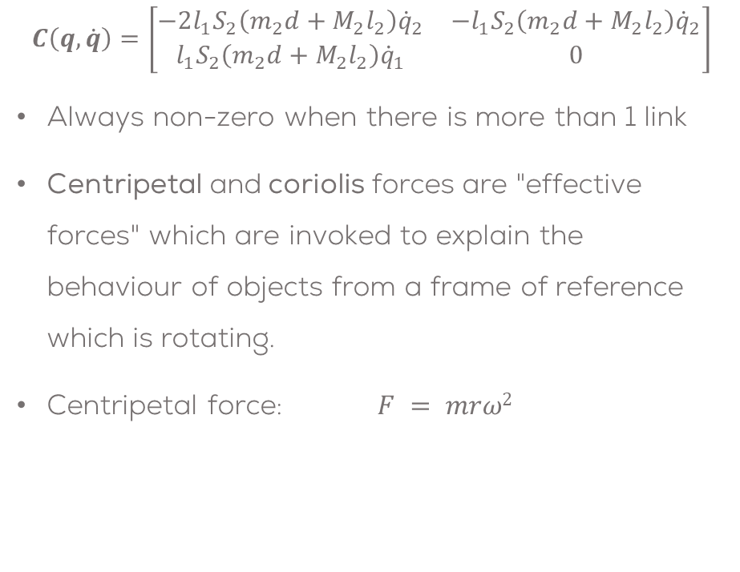
Interpreting $C(q,\dot{q})\dot{q}$
$$C\left(q,\dot{q}\right)=\left[\begin{matrix}−2l_{1}S_{2}\left(m_{2}d+M_{2}l_{2}\right){\dot{q}}_{2} & −l_{1}S_{2}\left(m_{2}d+M_{2}l_{2}\right){\dot{q}}_{2} \\ l_{1}S_{2}\left(m_{2}d+M_{2}l_{2}\right){\dot{q}}_{1} & 0\end{matrix}\right]$$
Always non-zero when there is more than 1 link
Centripetal and coriolis forces are "effective forces" which are invoked to explain the behaviour of objects from a frame of reference which is rotating.
Centripetal force: $F = mrω2$
Centripetal effects
Coriolis effects

Slide 26
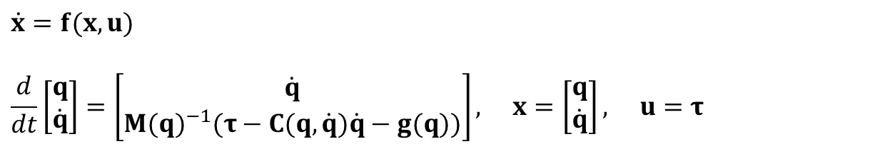
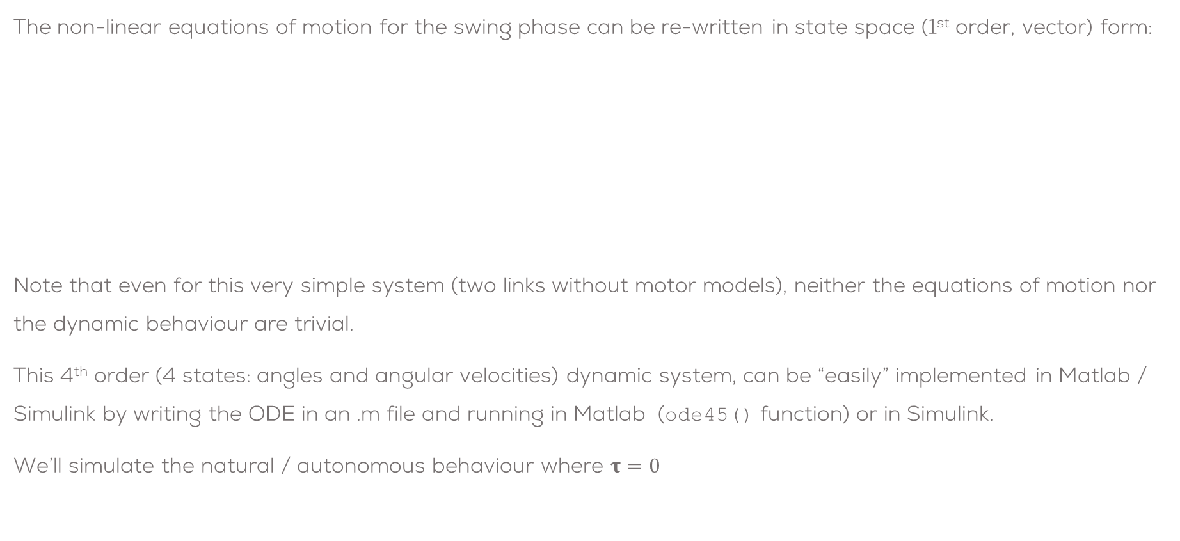
Non-linear, State Space Swing Phase
The non-linear equations of motion for the swing phase can be re-written in state space (1st order, vector) form:
Note that even for this very simple system (two links without motor models), neither the equations of motion nor the dynamic behaviour are trivial.
This 4th order (4 states: angles and angular velocities) dynamic system, can be “easily” implemented in Matlab / Simulink by writing the ODE in an .m file and running in Matlab (ode45() function) or in Simulink.
We’ll simulate the natural / autonomous behaviour where $τ=0$
$$\dot{x}=f(x,u)$$
$$\frac{d}{dt}\left[\begin{matrix}q \\ \dot{q}\end{matrix}\right]=\left[\begin{matrix}\dot{q} \\ M(q)^{−1}(τ−C(q,\dot{q})\dot{q}−g(q))\end{matrix}\right], x=\left[\begin{matrix}q \\ \dot{q}\end{matrix}\right], u=τ$$

Slide 27
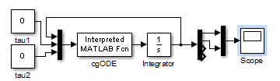
Swing Phase ODE Implementation
function dx = cgODE(x, u)
dx = zeros(4,1);
% ODE parameters
m = 5; M = 10; g = 9.8;
l = 1; a = 0.5; b = 0.5;
% Define ODE terms
Mm = [M*l^2+m*(l^2+a^2+b^2+2*b*l*cos(x(2))), m*b*(b+l*cos(x(2))); ...
m*b*(b+l*cos(x(2))), m*b^2];
Cq = [-2*m*b*l*sin(x(2))*x(3)*x(4)-m*b*l*sin(x(2))*x(4)^2; ...
m*b*l*sin(x(2))*x(3)^2];
gv = g*[(m*a+m*l+M*l)*cos(x(1))+m*b*cos(x(1)+x(2)); ...
m*b*cos(x(1)+x(2))];
% Calculate xdot = f(x)
dx(1:2) = x(3:4);
dx(3:4) = inv(Mm)*(u-Cq-gv);

Slide 28
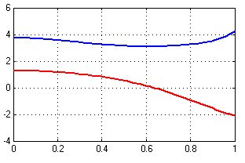

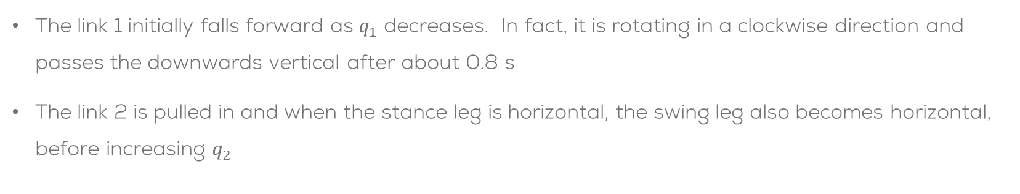










Initial Simulation Results
$$q_{2}$$
$$p_{2}$$
$$q_{2}$$
$$M$$
$$q_{1}$$
$$p_{1}$$
$$p_{3}$$
$$m$$
$$m$$
$$p_{0}$$
$$q_{1}$$
The link 1 initially falls forward as $q_{1}$ decreases. In fact, it is rotating in a clockwise direction and passes the downwards vertical after about 0.8 s
The link 2 is pulled in and when the stance leg is horizontal, the swing leg also becomes horizontal, before increasing $q_{2}$

Slide 29
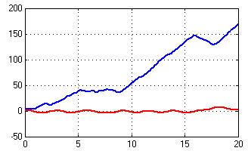


3.5 Long Term Simulation Results
$$q_{2}$$
$$q_{1}$$
The long term behaviour of the two link system is chaotic, it is extremely sensitive to the initial conditions
We won’t prove its chaotic, but the unstable behaviour (exponential divergence) coupled with the folding (rotating links) is characteristic of chaotic systems
http://en.wikipedia.org/wiki/Double_pendulum (info + animation)

Slide 30
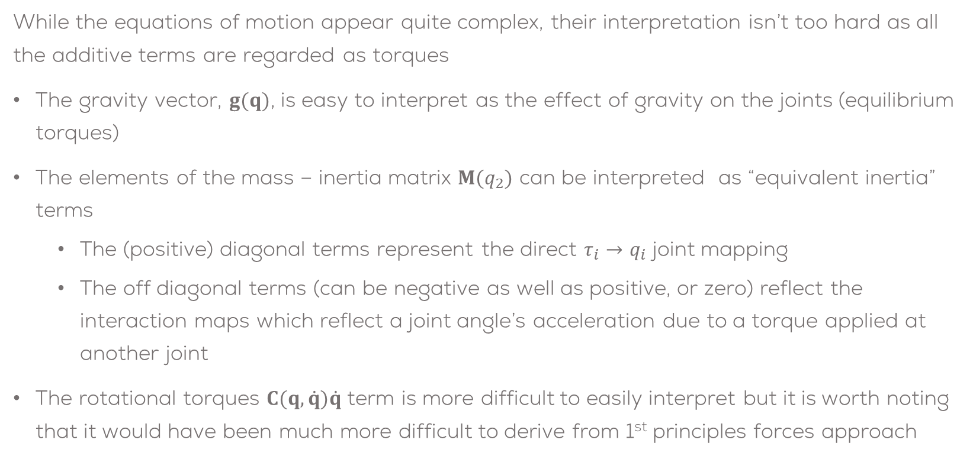
Conclusions
While the equations of motion appear quite complex, their interpretation isn’t too hard as all the additive terms are regarded as torques
The gravity vector, $g(q)$, is easy to interpret as the effect of gravity on the joints (equilibrium torques)
The elements of the mass – inertia matrix $M(q_{2})$ can be interpreted as “equivalent inertia” terms
The (positive) diagonal terms represent the direct $τ_{i}→q_{i}$ joint mapping
The off diagonal terms (can be negative as well as positive, or zero) reflect the interaction maps which reflect a joint angle’s acceleration due to a torque applied at another joint
The rotational torques $C(q,\dot{q})\dot{q}$ term is more difficult to easily interpret but it is worth noting that it would have been much more difficult to derive from 1st principles forces approach

